Slide 1



JAL JEEVAN MISSION
NABARD CONSULTANCY SERVICES
PROGRESS REPORT
DISTRICT: SOLAPUR
PUNE REGION
MARCH, 2023

Slide 2
District Work Status
Taluka | Category | No. of Schemes | Work Order Issued | Work In Progress | Work Not Started
Akkalkot | Retro | 68 | 49 | 18 | 31
 | New | 3 | 1 | 1 | 0
Karmala | Retro | 89 | 32 | 4 | 28
 | New | 8 | 4 | 0 | 4
Madha | Retro | 92 | 52 | 6 | 46
 | New | 4 | 1 | 0 | 1
Malsiras | Retro | 55 | 24 | 4 | 20
 | New | 0 | 0 | 0 | 0
North Solapur | Retro | 29 | 20 | 4 | 16
 | New | 0 | 0 | 0 | 0
South Solapur | Retro | 62 | 39 | 12 | 27
 | New | 4 | 2 | 1 | 1
Total | Retro | 395 | 216 | 48 | 168
 | New | 19 | 8 | 2 | 6
Grand Total |  | 414 | 224 | 50 | 174

Slide 3
Executive Summary Work in Progress Schemes
Taluka | Category | Total No. of Schemes | No. of Schemes based on Physical Progress %
 |  |  | < 25% | 25 < 50% | 50 < 75% | 75 < 100% | Commissioned
Akkalkot | Retro | 18 | 14 | 2 | 1 | 1 | 0
 | New | 1 | 1 | 0 | 0 | 0 | 0
Karmala | Retro | 4 | 4 | 0 | 0 | 0 | 0
 | New | 0 | 0 | 0 | 0 | 0 | 0
Madha | Retro | 6 | 6 | 0 | 0 | 0 | 0
 | New | 0 | 0 | 0 | 0 | 0 | 0
Malsiras | Retro | 4 | 4 | 0 | 0 | 0 | 0
 | New | 0 | 0 | 0 | 0 | 0 | 0
North Solapur | Retro | 4 | 4 | 0 | 0 | 0 | 0
 | New | 0 | 0 | 0 | 0 | 0 | 0
South Solapur | Retro | 12 | 6 | 4 | 2 | 0 | 0
 | New | 1 | 1 | 0 | 0 | 0 | 0
Total | Retro | 48 | 38 | 6 | 3 | 1 | 0
 | New | 2 | 2 | 0 | 0 | 0 | 0
Grand Total |  | 50 | 40 | 6 | 3 | 1 | 0

Slide 4
Abstract of Schemes – Work in Progress Category – “Retro”
Sr No | Scheme Name | Name of Agency | W.O. Amount (excl GST) | W.O. Date | Construction Period | Physical Progress | RA Bill (Recommended) % | RA Bill (Recommended) In Lakhs
Akkalkot Taluka | Akkalkot Taluka
1 | Baranpur | Suryakant Birajdar | 33,22,261 | 04-10-2022 | 12 | 90.78% | - | -
2 | Kalappawadi | Bhimashankar Rathod | 95,48,546 | 11-08-2022 | 12 | 55.67% | - | -
3 | Nimgaon | Mustafa Balurgi | 15,99,475 | 04-11-2022 | 12 | 44.71% | - | -
4 | Shawal | Tirupati Construction | 1,49,12,452 | 25-01-2023 | 12 | 39.79% | - | -
5 | Itagi | R.K. Construction | 27,26,968 | 08-01-2023 | 12 | 21.42% | - | -
6 | Kumthe | Adarsh Sanjiv Patil | 32,24,658 | 15-09-2022 | 12 | 18.56% | - | -
7 | Ankalagi | R.K. Construction | 1,16,17,096 | 12-09-2022 | 12 | 18.34% | - | -
8 | Bhosge & Bhosage Tanda | Sanjay Shivaji Kale | 91,19,846 | 26-07-2022 | 12 | 17.29% | - | -
9 | Mugali | Mahesh Tukaram Bedre | 92,84,308 | 02-12-2022 | 12 | 15.41% | - | -
10 | Goudgaon (Kh) | Suryakant Birajdar | 32,11,454 | 04-10-2022 | 12 | 9.52% | - | -
11 | Kegaon (Bk) | Suryakant Birajdar | 51,55,273 | 04-10-2022 | 12 | 9.16% | - | -
12 | Alage | R.K. Construction | 1,04,14,674 | 12-09-2022 | 12 | 6.80% | - | -
13 | Mhaisalagi | Vivek Vithal Rathod | 98,31,677 | 18-11-2022 | 12 | 4.63% | - | -

Slide 5
Abstract of Schemes – Work in Progress Category – “Retro”
Sr No | Scheme Name | Name of Agency | W.O. Amount (excl GST) | W.O. Date | Construction Period | Physical Progress | RA Bill (Recommended) % | RA Bill (Recommended) In Lakhs
14 | Salgar | R.K. Construction | 99,72,360 | 02-09-2022 | 12 | 4.46% | - | -
15 | Sangvi Khurd | Bhimashankar Rathod | 58,77,839 | 18-01-2023 | 12 | 2.03% | - | -
16 | Halahlli | Ashif Mahamad | 63,58,936 | 16-01-2023 | 12 | 1.55% | - | -
17 | Talewade | Vikas Kumbhar | 80,21,612 | 25-01-2023 | 12 | 0.97% | - | -
18 | Sinnur | Sanjay Shivaji Kale | 1,01,55,642 | 16-01-2023 | 12 | 0.45% | - | -
Karmala Taluka | Karmala Taluka
19 | Roshewadi | Ramraj Construction | 48,37,909 | 17-01-2023 | 12 | 8.57% | - | -
20 | Wangi 2 | Swami Samarth Enterprises | 37,95,938 | 30-12-2022 | 12 | 1.99% | - | -
21 | Mangi | Rockline Construction | 1,12,92,235 | 23-01-2023 | 12 | 0.60% | - | -
22 | Korti | Swami Samarth Enterprises | 1,31,18,116 | 27-01-2023 | 12 | 0.16% | - | -
Madha Taluka | Madha Taluka
23 | Hole Kh | Sudarshan Gadge | 56,82,031 | 31-12-2022 | 12 | 19.79% | - | -
24 | Surli | Eagle Infra | 66,35,317 | 24-01-2023 | 12 | 17.32% | - | -
25 | Wadoli | Sunil Patil | 59,39,082 | 20-12-2022 | 12 | 3.89% | - | -

Slide 6
Abstract of Schemes – Work in Progress Category – “Retro”
Sr No | Scheme Name | Name of Agency | W.O. Amount (excl GST) | W.O. Date | Construction Period | Physical Progress | RA Bill (Recommended) % | RA Bill (Recommended) In Lakhs
26 | Nagorli | Sunil Patil | 1,11,46,847 | 20-12-2022 | 12 | 3.45% | - | -
27 | Aran | Sanchiti Construction | 1,66,32,386 | 23-01-2023 | 12 | 3.29% | - | -
28 | Ranzani | Amar Kantilal | 1,24,92,118 | 19-01-2023 | 12 | 0.87% | - | -
Malsiras Taluka | Malsiras Taluka
29 | Tandulwadi | Mahendra Deshmukh | 1,54,84,433 | 25-01-2023 | 12 | 22.56% | - | -
30 | Islampur | Neha Borewell | 31,81,289 | 30-06-2022 | 12 | 17.15% | - | -
31 | Sulewadi | Balaji Infra | 79,38,294 | 20-01-2023 | 12 | 5.02% | - | -
32 | Karunde | Jyotibaraje Construction | 1,49,83,180 | 20-01-2023 | 12 | 4.64% | - | -
North Solapur | North Solapur
33 | Gulwanchi | Tirupati Construction | 1,44,34,310 | 25-03-2023 | 12 | 24.06% | - | -
34 | Pathari | S.S. Sathe | 84,45,161 | 10-08-2022 | 12 | 14.57% | - | -
35 | Padsali | Prasad Sunil Pawar | 56,40,473 | 17-08-2022 | 12 | 2.56% | - | -
36 | Tirhe | Yash Construction | 1,49,14,350 | 25-01-2023 | 12 | 0.85% | - | -

Slide 7
Abstract of Schemes – Work in Progress Category – “Retro”
Sr No | Scheme Name | Name of Agency | W.O. Amount (excl GST) | W.O. Date | Construction Period | Physical Progress | RA Bill (Recommended) % | RA Bill (Recommended) In Lakhs
South Solapur | South Solapur
37 | Darganhalli | Vinod Birajdar | 1,33,96,670 | 19-07-2022 | 12 | 53.92% | - | -
38 | Shirval | Suryakant Birajdar | 74,44,365 | 04-10-2022 | 12 | 51.88% | - | -
39 | Kanbas | Bhimashankar Rathod | 69,03,708 | 17-11-2022 | 12 | 35.17% | - | -
40 | Wadaji | Bhimashankar Rathod | 71,42,242 | 18-01-2023 | 12 | 28.97% | - | -
41 | Hattarsang | Nirmal Infrastructure | 96,66,254 | 25-01-2023 | 12 | 28.85% | - | -
42 | Alegaon | Suryakant Birajdar | 32,69,061 | 24-01-2023 | 12 | 26.21% | - | -
43 | Chinchpur | Bhimashankar Rathod | 73,67,147 | 08-01-2023 | 12 | 10.24% | - | -
44 | Hanamgaon | Bhimashankar Rathod | 60,59,821 | 18-01-2023 | 12 | 9.87% | - | -
45 | Tandulwadi | R.K. Construction | 1,05,78,442 | 13-09-2022 | 12 | 6.90% | - | -
46 | Gangewadi | Suryakant Birajdar | 55,62,386 | 18-01-2023 | 12 | 5.96% | - | -
47 | Chandrahal | Hamulal Construction | 66,02,918 | 17-01-2023 | 12 | 5.16% | - | -
48 | Kudal | Bhimashankar Rathod | 47,81,537 | 18-01-2023 | 12 | 0.53% | - | -

Slide 8
Abstract of Schemes – Work in Progress Category – “New”
Sr No | Scheme Name | Name of Agency | W.O. Amount (excl GST) | W.O. Date | Construction Period | Physical Progress | RA Bill (Recommended) % | RA Bill (Recommended) In Lakhs
Akkalkot Taluka | Akkalkot Taluka
1 | Rampur | Vilasrao Deshmukh Majur Sahakari Sanstha Maryadit | 17,15,248 | 11-11-2022 | 12 | 4.18% | - | -
South Solapur | South Solapur
2 | Barur | Suryakant Birajdar | 92,24,300 | 09-11-2022 | 12 | 1.19% | - | -

Slide 9
DASHBOARD

Slide 10
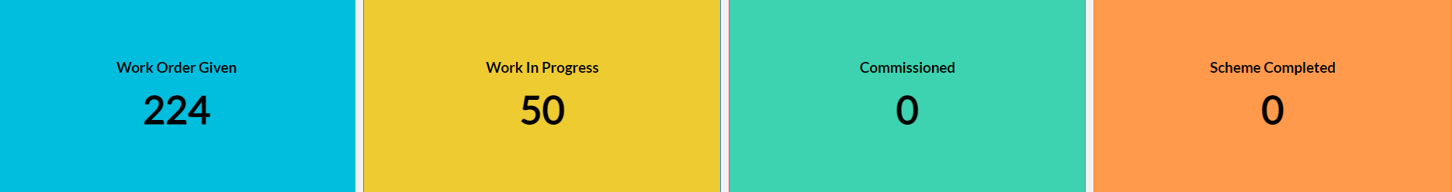
Dashboard
Work Status

Slide 11
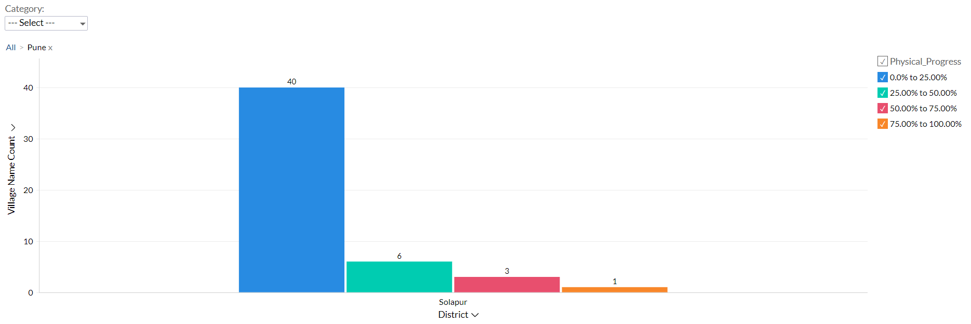
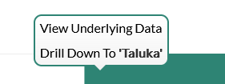
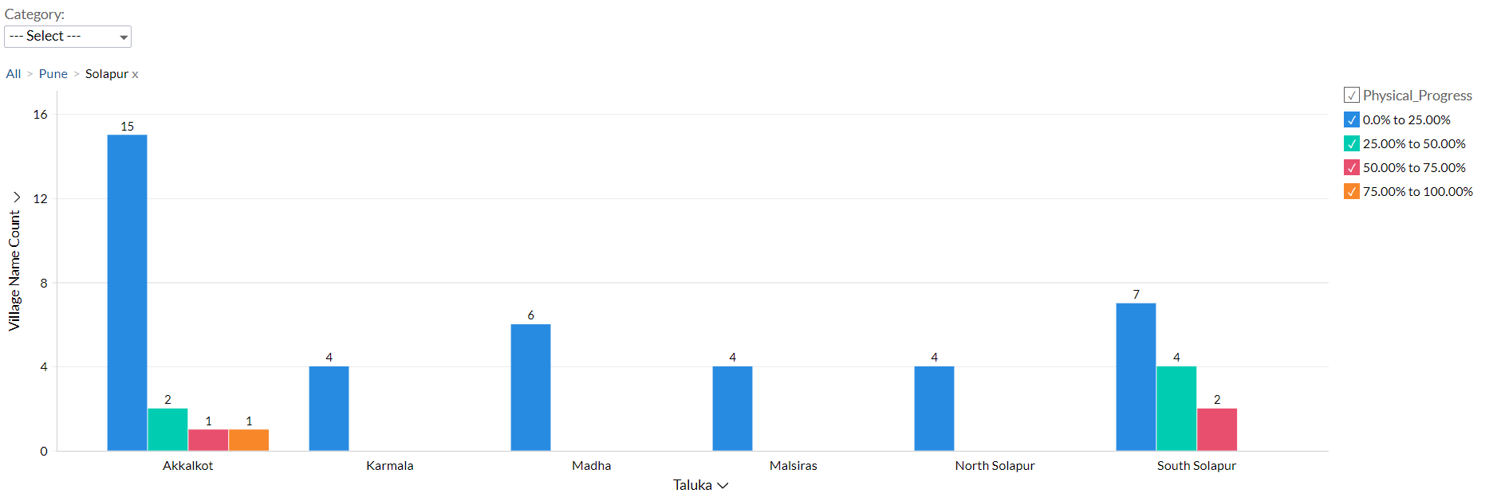
Dashboard
Progress Milestone

Slide 12
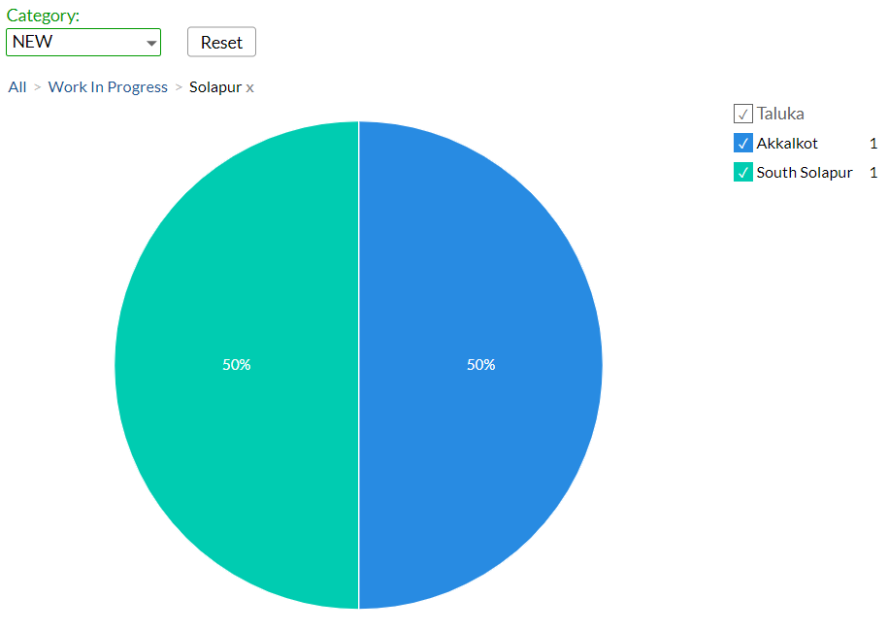
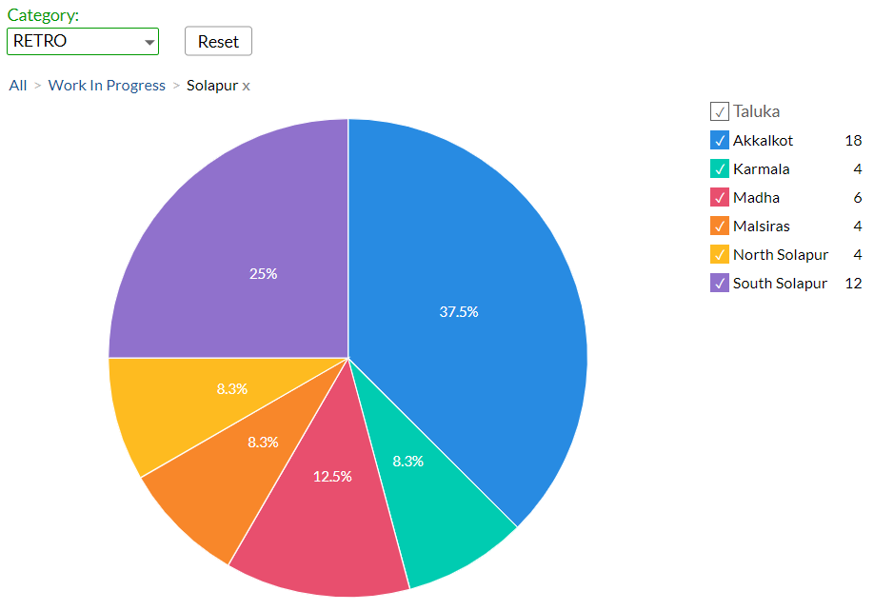
Dashboard
Work Status: “New Schemes”
Work Status: “Retro Schemes”

Slide 13
MS – PROJECT
Work in Progress Schemes

Slide 14
Project Overview Physical Progress vs Financial Progress vs Time Overrun

Slide 15
Late Schemes

Slide 16
SAMPLE SITE VISIT PHOTOS

Slide 17
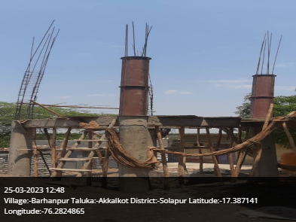
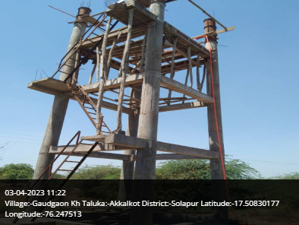
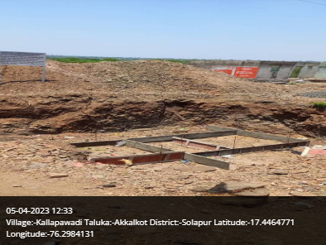
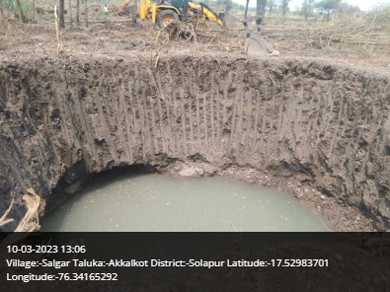
Akkalkot Taluka

Slide 18
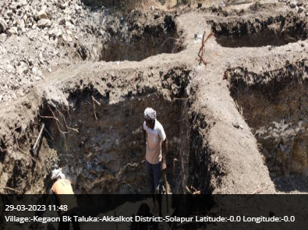
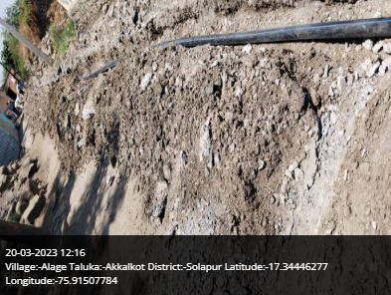
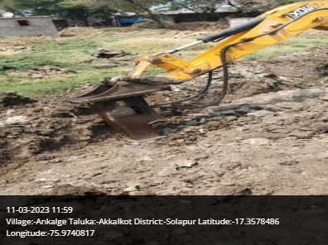
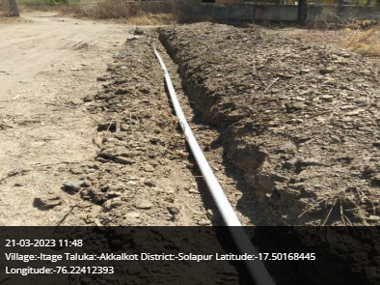
Akkalkot Taluka

Slide 19
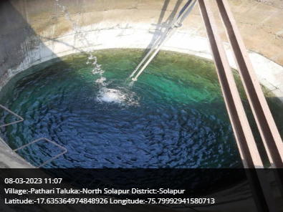
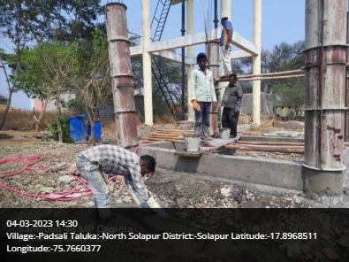
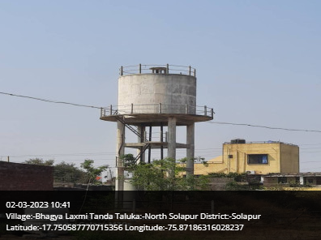
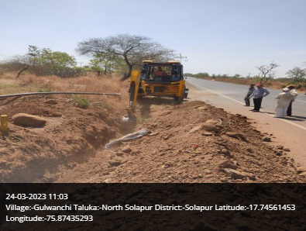
North Solapur Taluka

Slide 20
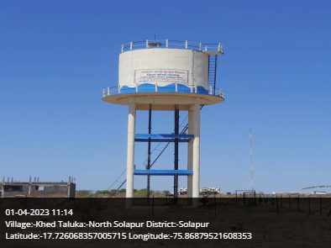
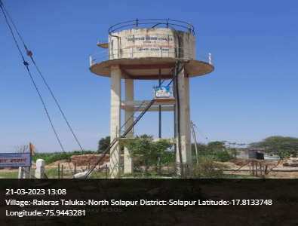
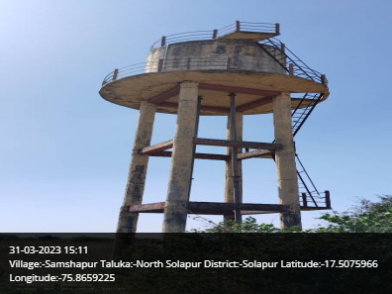
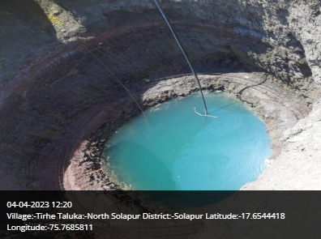
North Solapur Taluka

Slide 21
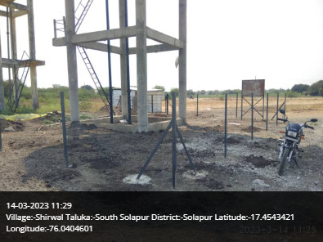
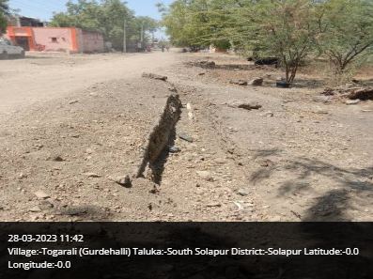
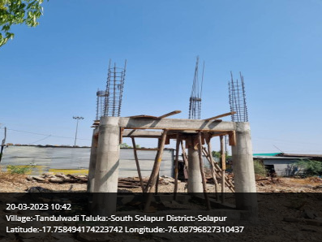
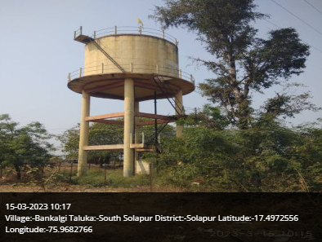
South Solapur Taluka

Slide 22
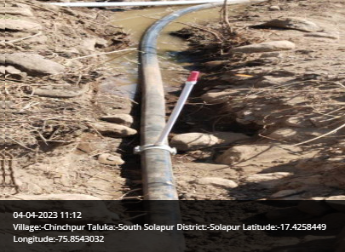
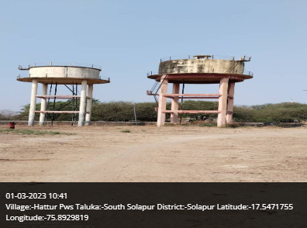
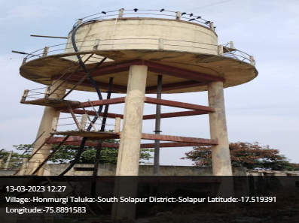
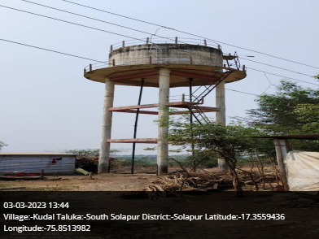
South Solapur Taluka

Slide 23
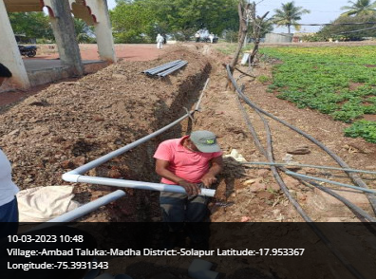
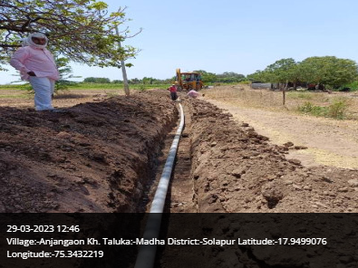
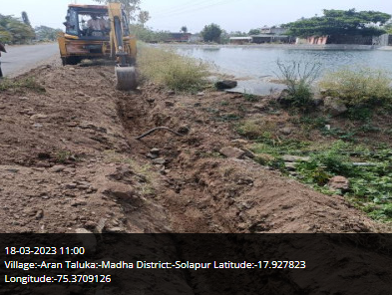
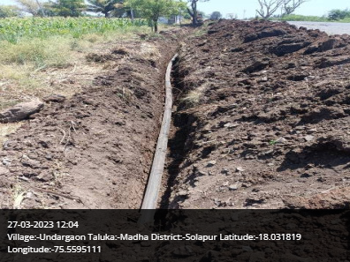
Madha Taluka

Slide 24
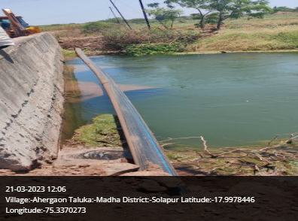
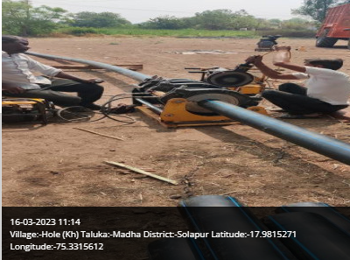
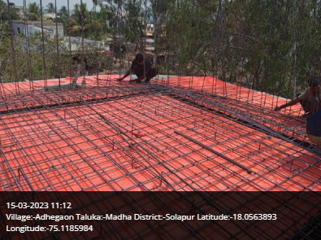
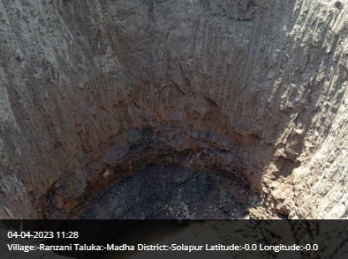
Madha Taluka

Slide 25
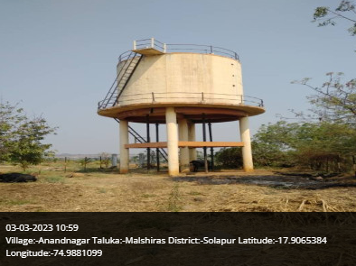
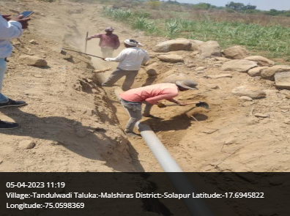
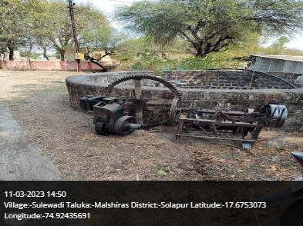
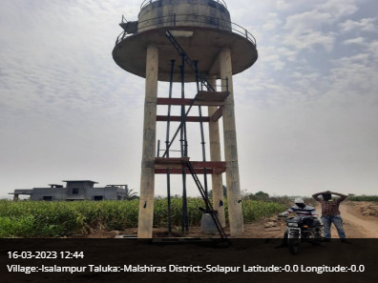
Malshiras Taluka

Slide 26
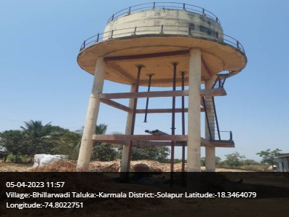
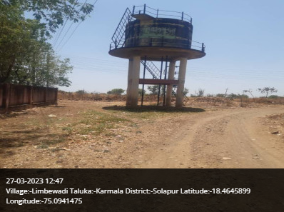
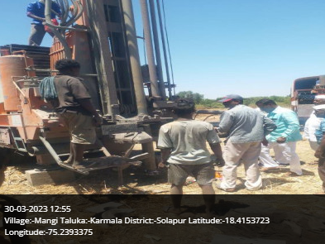
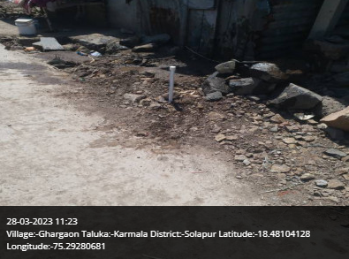
Malshiras Taluka

Slide 27

Thank You!

